Slide 1
Predicting Heart Disease Using Machine Learning Classification Models
Isaac McPadden
University of Denver
COMP 4448 Data Science Tools 2
Dr. Neba Nfonsang
Presentation Link: https://youtu.be/LqgyhJ1OfNY

Slide 2
Purpose
Develop and compare different classification models to predict if a person has heart disease
Stochastic Gradient Descent (SGD)
Random Forest (RF)
K Nearest Neighbors (KNN)
Linear Support Vector Classifier (LSVC)
General Support Vector Classifier (SVC)

Slide 3
Significance
Heart disease is a leading cause of death in the US
Save lives
Save on healthcare costs

Slide 4
Research Question
Can machine learning classification algorithms be used to predict if a person has heart disease, and if so, which classification algorithm is best, SGD, RF, KNN, LSVC, or SVC?

Slide 5
The Data
Subset of the CDC’s 2015 BRFSS survey
21 Features from over 300 selected by Kaggle user Alex Teboul
Health metrics, ex: BMI
Self reported health behaviors, ex: general health rating
Demographics, ex: age, income

Slide 6
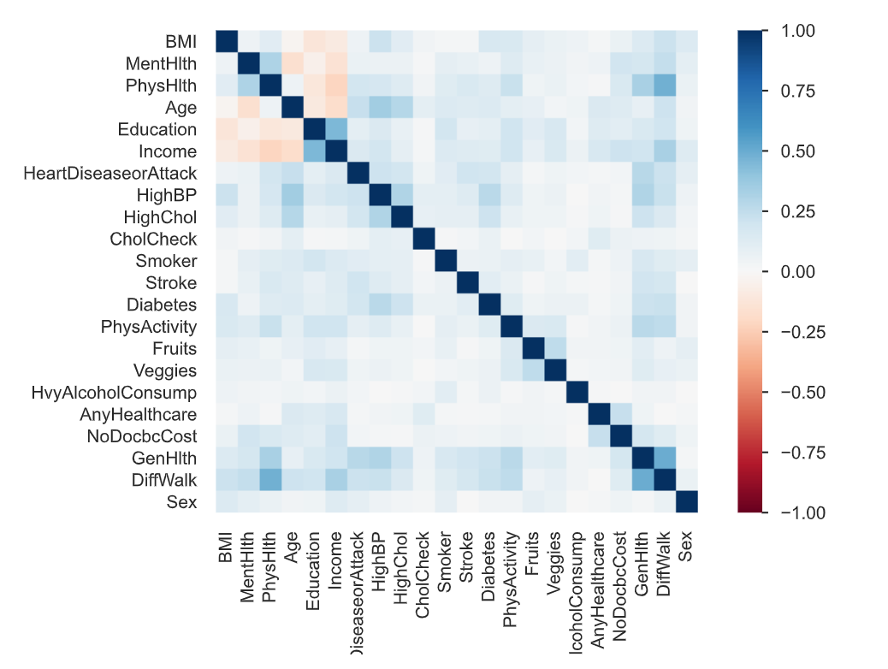
Exploratory Data Analysis
Mostly binary, unbalanced
Target variable is highly unbalanced
Weak correlation between variables, low redundancy in data
Some duplicates in the data but not surprising

Slide 7
Data Splitting
70:30 Train Test split
1 binary target, 21 features
21 features narrowed down to 8 and then 5
Subset taken with balanced target

Slide 8
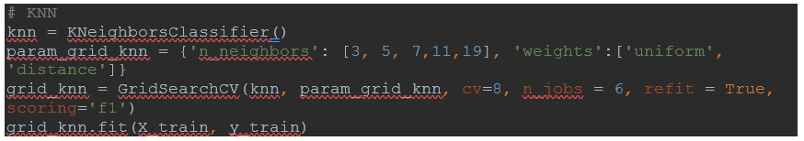
Model Building
Classifier
Parameter Grid
Grid Search
Fit Model
F1 Score
Using the KNN model as example

Slide 9
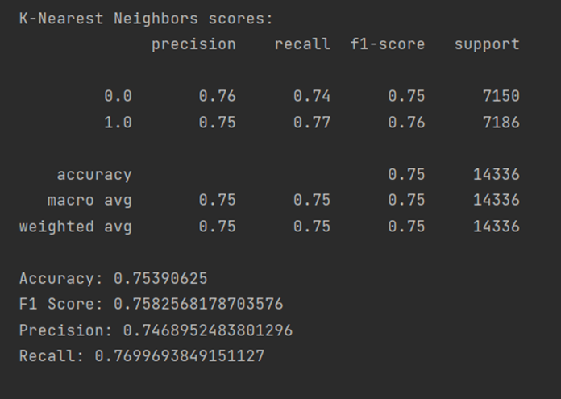
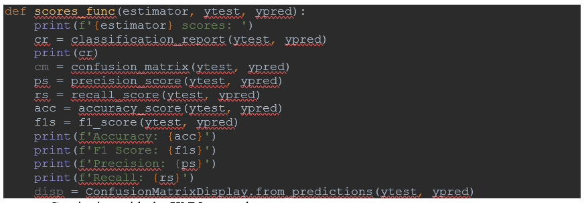
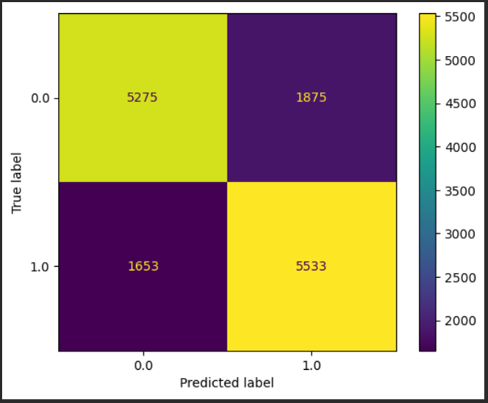
Model Building
Model is tested
Scores are printed

Slide 10
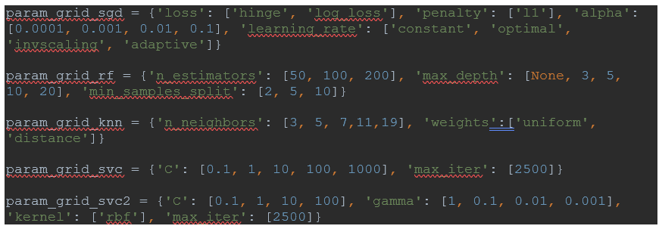
Model Optimization and Selection
Started with all data
Reduced features to 8
Used recursive feature elimination to choose 8 statistically supported features
Selected subset of original dataset to have balanced target
Tried 5 features

Slide 11
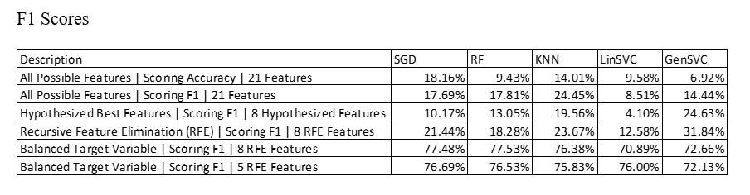
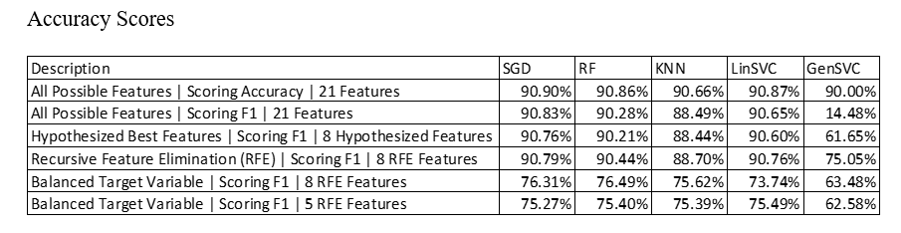
Model Comparison

Slide 12
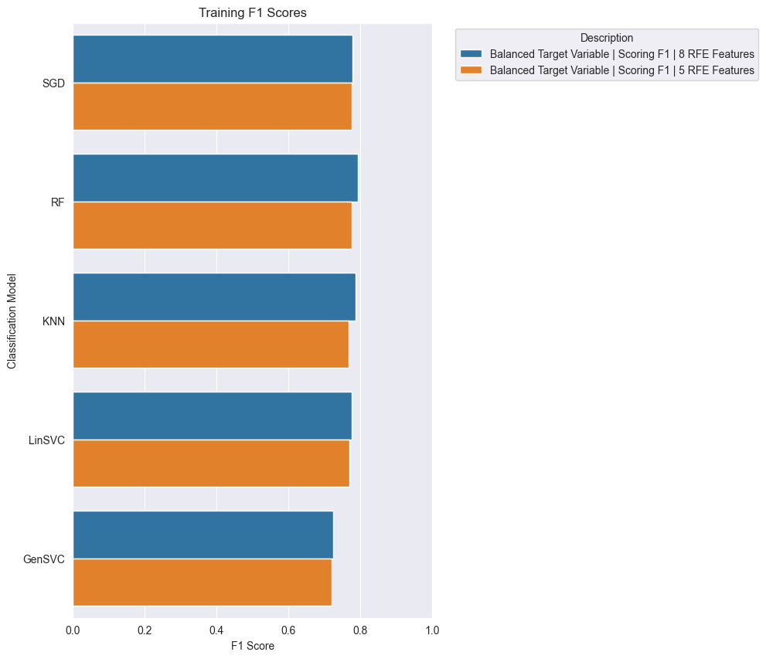
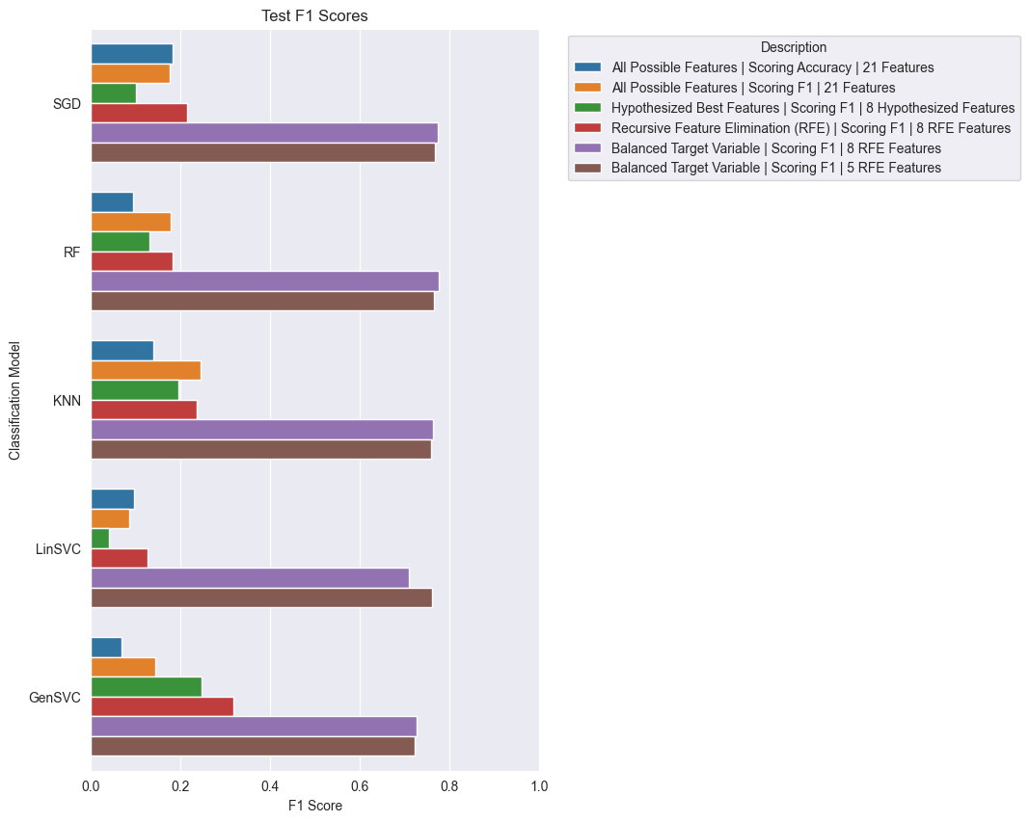
Model Comparison

Slide 13
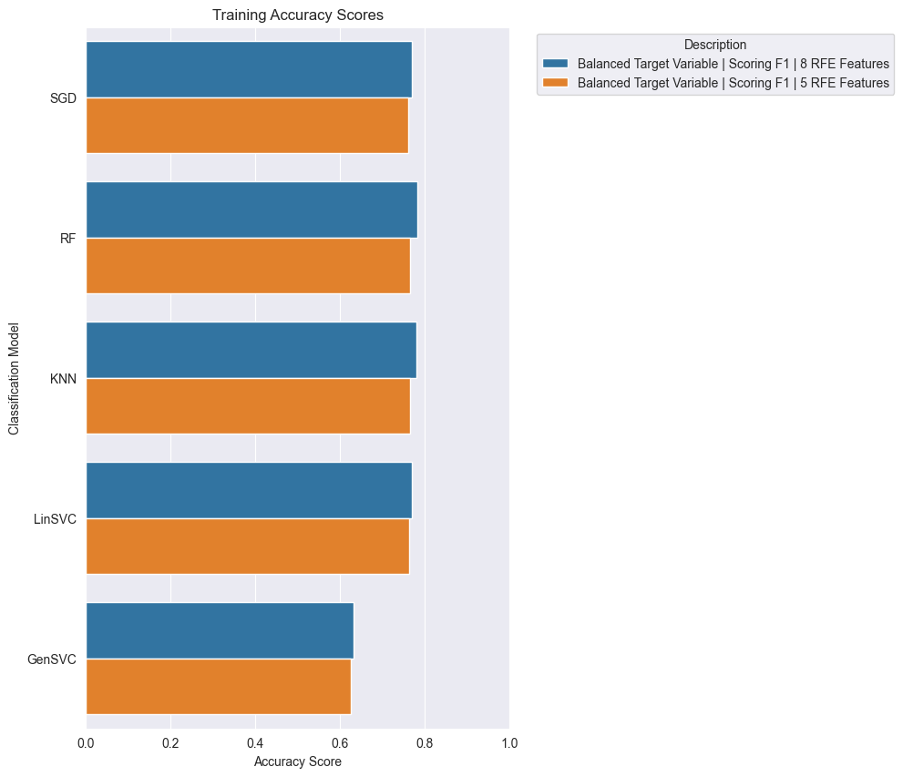
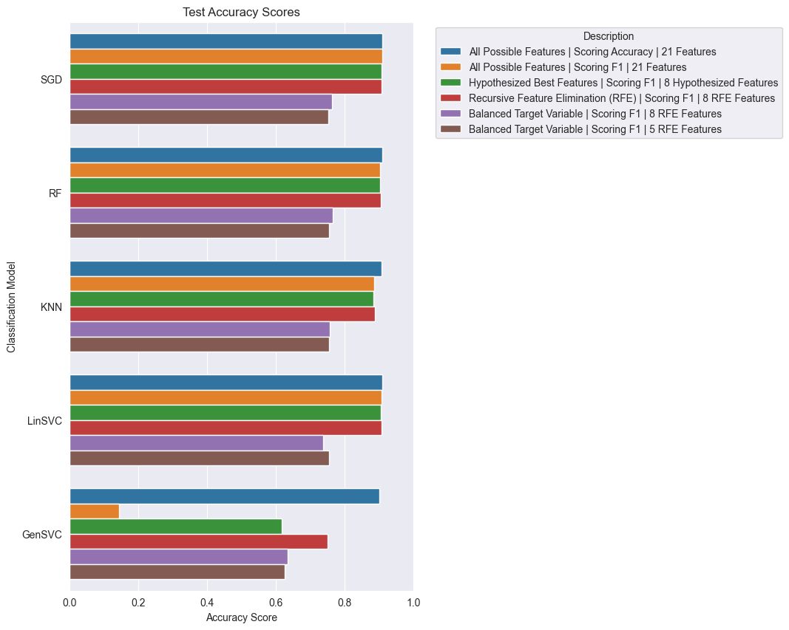
Model Comparison

Slide 14
Model Comparison

Slide 15
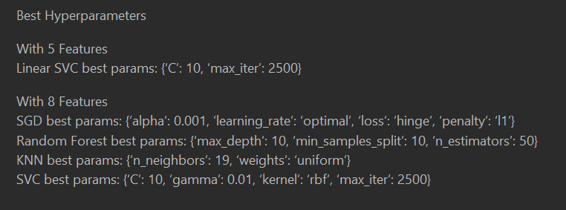
Model Comparison

Slide 16
Conclusion, Lessons Learned, and Recommendations
Random Forest
8 Features chosen by RFE
Max Depth of 10
Minimal Samples Split of 10
N Estimators Value of 50
F1 Score: 77.53 percent
Accuracy Score: 76.49 percent
Cannot replace visit to a real doctor
Potential Improvements: More RFE variable counts, deep learning
Could still be useful data point for doctor to assess heart disease risk

Slide 17
Conclusion, Lessons Learned, and Recommendations
Having balanced data supplied to a classification model is more important than having a target variable representative of the general population.
RFE can greatly improve the performance and speed of classification models.
Iterative models need a maximum number of iterations or the model will never finish training in some cases.
Human health is more complicated than a survey can account for.

